Slide 1

Enhancing Human-Robot Interaction in Healthcare: A Study on Nonverbal Communication Cues and Trust Dynamics with NAO Robot Caregiver
Presented By:
S M Taslim Uddin Raju (21093036)
Instructor By :
Dr. Kerstin Dautenhahn
Professor,
Dept. of Electrical and Computer Engineering
University of Waterloo

Slide 2

Introduction
Existing Works
Problem Statement
Objectives
Research Questions
Methodology
Results
Discussion
Conclusion
Limitations and Future Works
References
Outline

Slide 3
Introduction
Objectives
Otcome
Introduction
According the Organization for Economic Co-operation and Development (OECD), by the middle of the 21st century, over 20% of the world’s population will be aged 65 and over [1].
As the population of older adults increases, so will the need for both human and robot care providers.
Traditional caregiving practices often involve hiring human caregivers, which expensive and may not always effectively meet the needs of older adults.
Human-robot interaction (HRI) is a rapidly expanding discipline exploring how humans and robots work together [2].
3

Slide 4
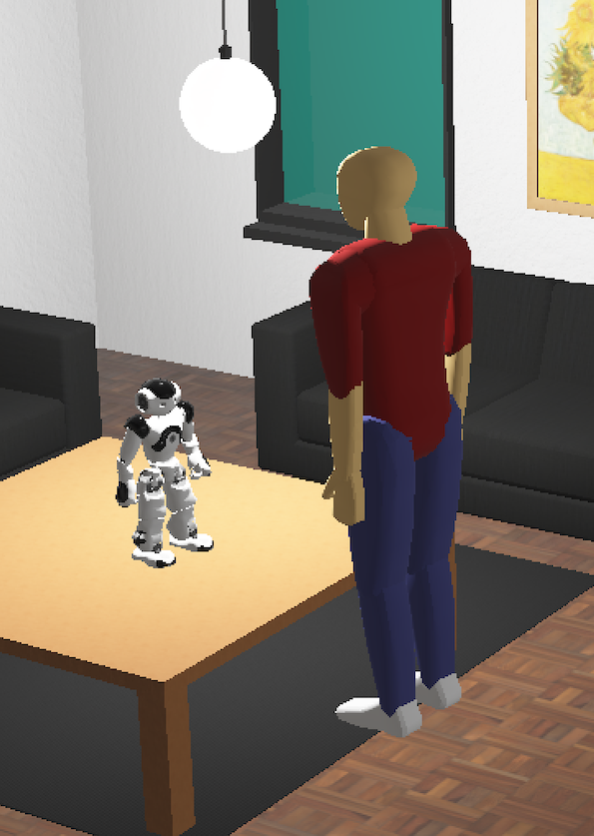
Introduction (Cont.)
Objectives
Otcome
Introduction
Non-verbal behaviors of robots, body movement, hand gesture, touch, are facilitating effective communication and interaction between humans and robots [3].
By adjusting their non verbal behaviors, robots can express empathy, and understanding, enhancing interaction quality and fostering trust and engagement.
This study explores the integration of Nao’s nonverbal behavior, in health monitoring and caregiving for older adults.
Fig. 1 : Webot simulation of apartment with Nao robot as caregiver
4

Slide 5
Existing Works
Objectives
Otcome
Existing Works
Mazursky et al. [4]
Investigate the impact of robot-initiated touch in healthcare settings, specifically focusing on factors influencing patient experience.
Explored how different variables such as touch presence, robot intent, appearance, and tone affect participant reactions.
Johnson et al. [5]
Explore the entertainment value of playing games with a humanoid robot Nao, particularly focusing on the game Mastermind.
Investigated the impact of multimodal behavioral patterns, which combined gestures, eye LED patterns, and speech to imitate various emotions.
5

Slide 6
Existing Works (cont.)
Objectives
Otcome
Existing Works
Akalin et al. [6]
Conducted a study to demonstrate the effectiveness of a Pepper robot equipped with non-verbal gestures for elder care
Enhance security and safety aspects in caregiving environments using the robot's arm gestures and head nodding.
6

Slide 7
Problem Statement
Objectives
Otcome
Problem Statement
Only few studies worked with robot for caregiver the older people
Need of specific application to the design and implementation of robotic caregivers like Nao in real-world settings.
Trust issue when Nao touch the older adults for the purpose of medical care
7

Slide 8
Objectives & Contributions
Objectives
Otcome
Objectives
Design the Nao robot with and elderly adults in healthcare setting
Manipulate nonverbal communication modalities, specifically unique combination of gestures and LED patterns and touch respectively.
Employ a mixed-methods approach with within-subject factorial design for assessing participant responses to different types of interactions and cues
Design the robot capabilities of serving the needs of the elderly to improve the quality of life for older adults
8

Slide 9
Objectives
Methodology
Otcome
Proposed Methodology
For Hemoglobin and Glucose level measurement
9

Slide 10
Research Questions
Objectives
Otcome
Methodology
RQ1: How the participants perceive when robot Nao touches to observe and monitor the participant’s health?
Explore participants' comfort levels, trust in the robot's capabilities, and overall satisfaction during touch-based monitoring.
RQ2: Can participants effectively understand and respond to various LED light patterns and gestures (hand and head movement) from the Nao robot?
Assess participants' understanding and responsiveness to various nonverbal cues.
Evaluate either LED light patterns or hand gestures better.
RQ3: What distinguishing factors influence trust between interactions involving human-human versus human-robot dynamics, specifically between older adults and care providers?
Investigate the factors influencing trust in interactions between older adults and robotic caregivers versus human care providers
10

Slide 11
Overall Design
Objectives
Methodology
Otcome
Design our overall scenario using Webots simulation due to the lack of Nao Robot
To evaluate our research questions we developed the various nonverbal cues:
Touch by Nao
Hand and head gestures by Nao
LED patterns used by Nao
Environmental Setup:
Environment consists of the Nao robot placed within an apartment with elderly adults
To simulate realistic interactions between older adults and the robot, we have devised two video scenarios
The Nao robot interacts with older adults to monitor people’s health conditions.
11

Slide 12
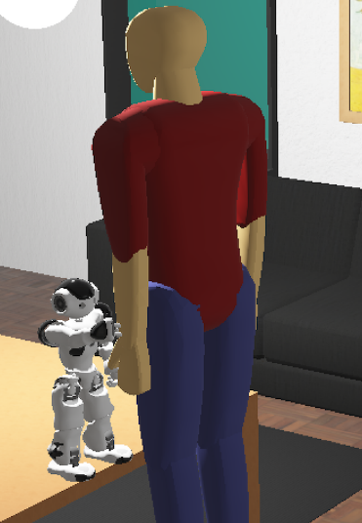
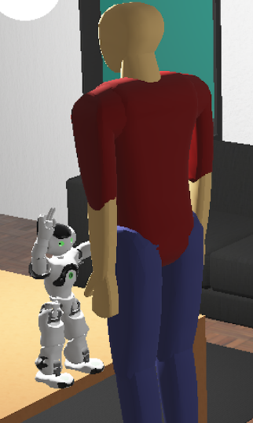
Objectives
Methodology
Otcome
Scenario 1: Positive Responses
In an apartment, an elderly individual stands in front of the Nao robot positioned on a table
Nao moves towards the elderly individual's hand to check their health condition through touch
The Nao robot interacts with older adults to monitor elder’s health conditions.
If heath is good then Nao express the positive vibes by
Change LED lights to green
Raise its arms in a welcoming gesture
Nods its head up and down
12
Fig. 2 : Positive gestures of Nao Robot

Slide 13
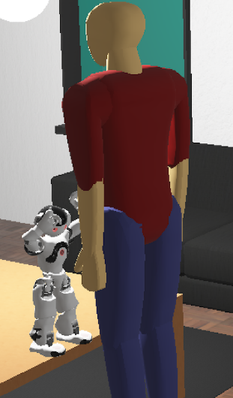
Objectives
Methodology
Otcome
Scenario 2: Negative Responses
If heath is not good then Nao express the negative vibes by
Change LED lights to red
Lift its arms to head
Nods its head left and right
Fig. 3 : Negative gestures of Nao Robot
13

Slide 14
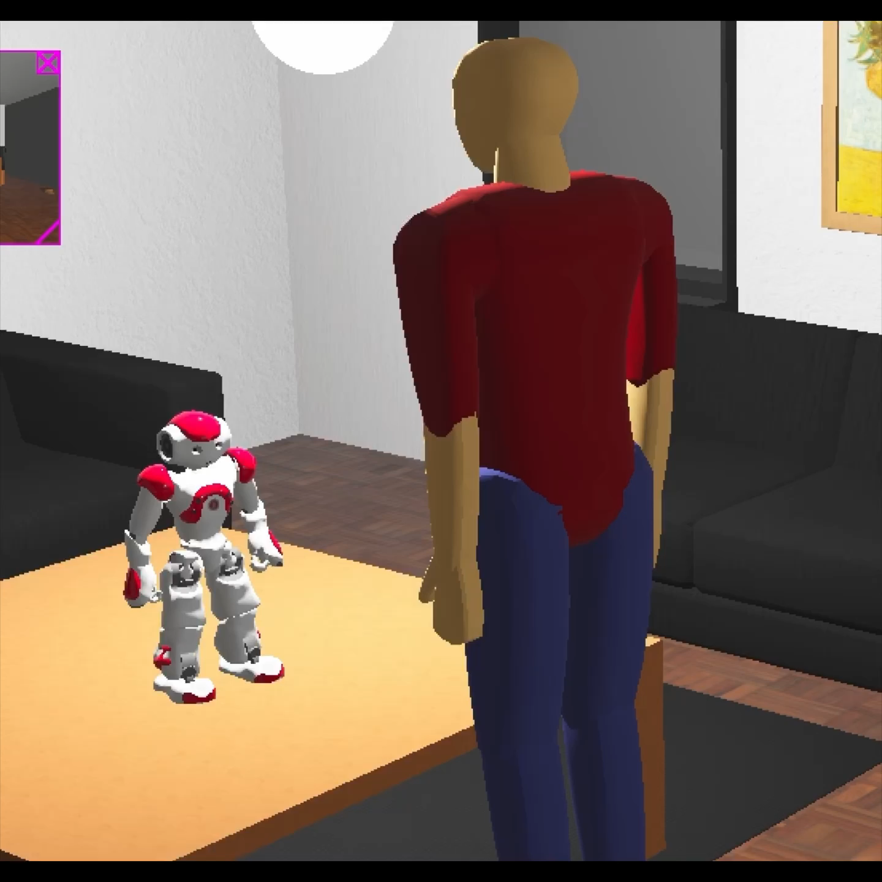
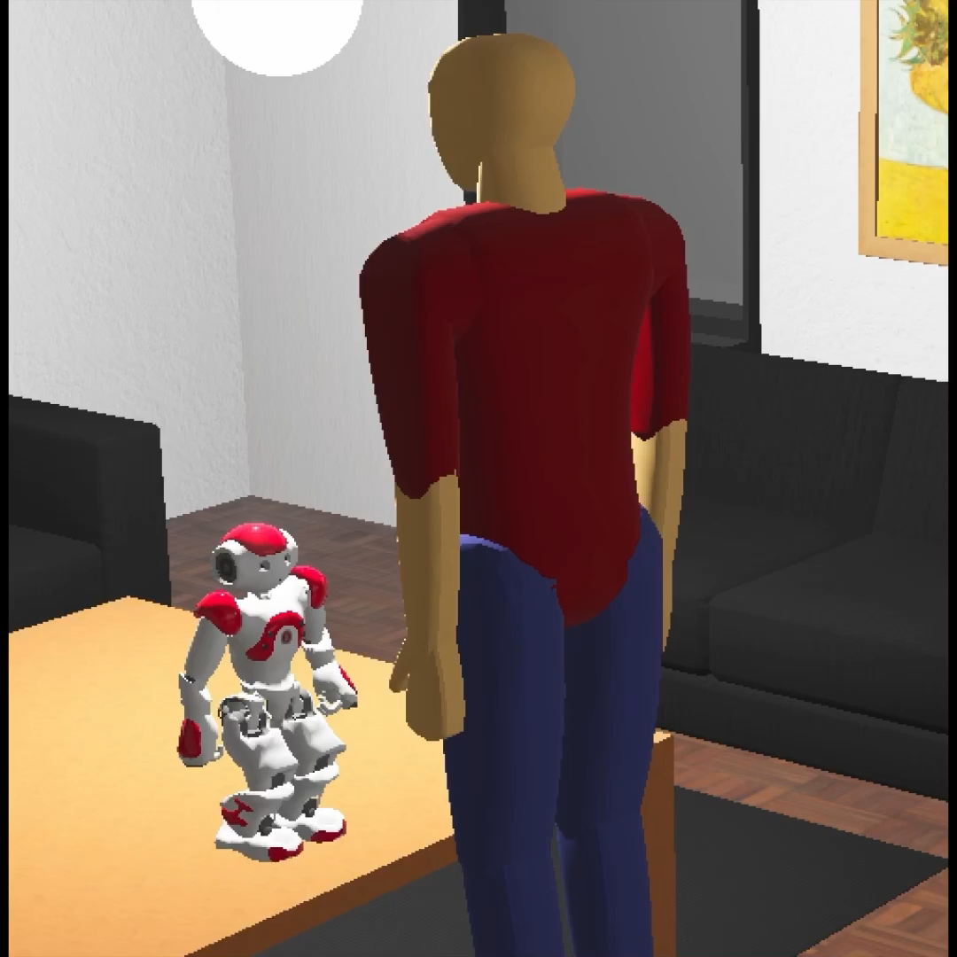
Objectives
Methodology
Otcome
Scenario 1: Positive Gesture
Scenario 2: Negative Gesture
14

Slide 15
Objectives
Methodology
Otcome
Manipulated Nao Touch Behavior
Nao has various basic commands and behaviors
Touch Manipulation
Nao robot has nine tactile sensors and eight pressure sensors [7]
In Webots simulation, it was challenging to manipulate the Nao sensors
rand() function, which generates either 1 or 0 when the Nao robot touches a human
When Nao generates a 1, it indicates a good health condition or positive vibes
When Nao generates a 0, it indicates a poor health condition or negative vibes
15

Slide 16
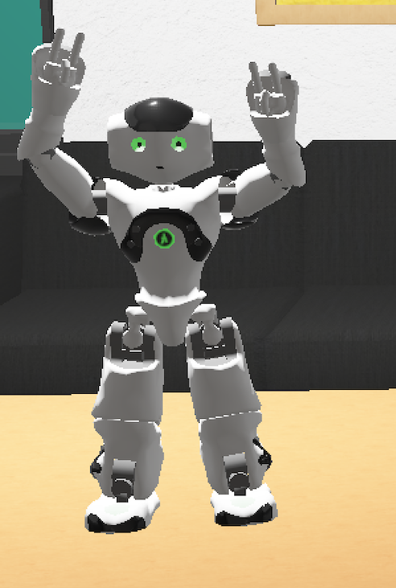
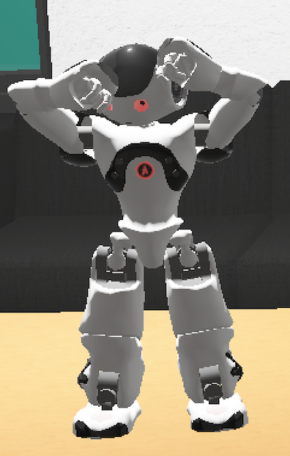
Objectives
Methodology
Otcome
Manipulated Nao Touch Behavior (cont.)
Hand and Head Gestures Manipulation
Nao uses these basic commands to navigate towards adult individuals.
We introduced three new hand gestures for health monitoring purposes: handshake(), sadmotion(), and happymotion()
When Nao generates a 1, it indicates the happymotion()
When Nao generates a 0, it indicates the sadmotion(),
(a) Positive (b) Negative
Fig. 4 : Snapshot of the Nao robot displaying: (a) Positive gesture the robot raises its arms and (b) negative gesture the robot lifts its arm to its head.
16

Slide 17
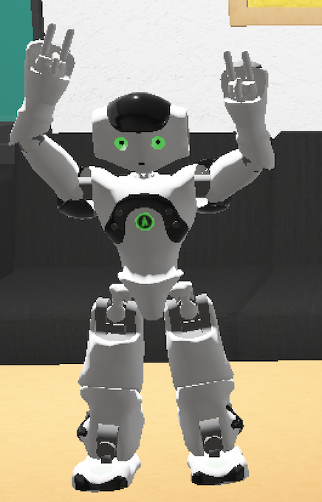
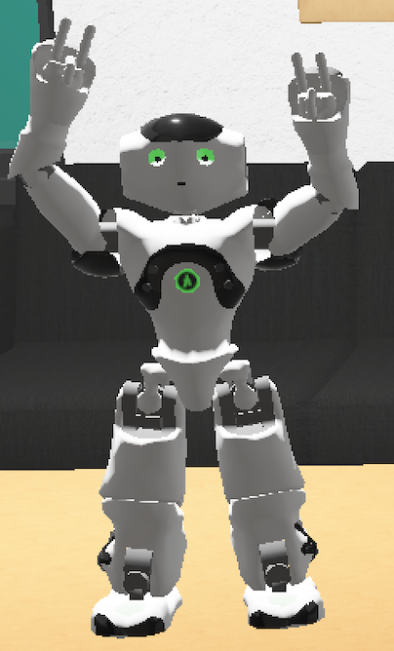
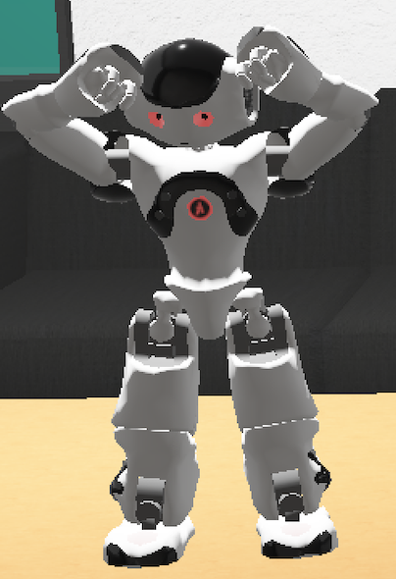
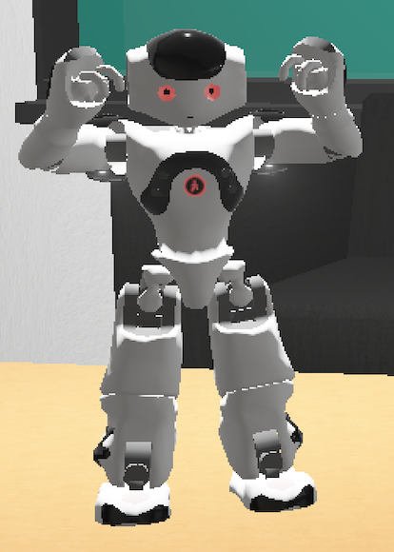
Objectives
Methodology
Otcome
Manipulated Nao Touch Behavior (cont.)
Hand and Head Gestures Manipulation (cont.)
(a) Nodding the head up and down (b) Nodding the head left to right
Fig. 5 : Snapshot of the Nao robot displaying: (a) Positive gesture and (b) Negative gesture
17

Slide 18
Objectives
Methodology
Otcome
Manipulated Nao Touch Behavior (cont.)
LED Patterns Manipulated
Manipulate the Nao robot’s two eye LEDs and ChestBoard LED.
Nao receives a value of 1, it shows the happy expression and changes the LED pattern GREEN color
Nao receives a value of 0, it shows the sad expression and changes the LED pattern RED color
(a) Green Color (b) Red Color
Fig. 6 : Snapshot of the Nao robot displaying: (a) Positive gesture and (b) Negative gesture
18

Slide 19
Objectives
Methodology
Otcome
Participants
Survey: Google Forms questionnaire that contained links to two simulation videos.
Eight students, aged between 22 and 28 (with ME= 24.75 and SD = 1.98), from the University of Waterloo
All participants had prior experience with robot interaction.
19

Slide 20
Objectives
Methodology
Otcome
Procedures
When the experiment starts, participants are requested to provide demographic details and complete a survey evaluating the Nao robot on its non-verbal cues.
Participants are shown two video scenarios featuring a robot caregiver conducting a medical screening
20

Slide 21
Objectives
Methodology
Otcome
Measures
The research questions aimed to evaluate participant experiences and perceptions in three main domains: perception, nonverbal communication efficiency (either LED or hand gesture, trustworthiness (4 independent variable)
Questionnaire items were assessed participant agreement on a 5-point Likert scale ranging from 1 Strongly Disagree) to 5 (Strongly Agree)
Employ mixed-methods approach with a within-subject factorial design for assessing participant responses based on 4 independent variables and 11 dependent variables.
21

Slide 22
Objectives
Methodology
Otcome
Measures (cont.)
Perception (for RQ1): Participants assessed specific aspects of Nao's touch-based health monitoring: tractability, comfortability, competency, and reliability
Efficiency of Nonverbal Communication (for RQ2): Participants assessed the effectiveness, understandability, and accuracy
Trustworthiness (for RQ3): Participants provided feedback on the following topics: interactivity, relationship dynamics, dependence, trust level
22

Slide 23
Objectives
Results & Discussion
Otcome
Results and Discussion

Slide 24
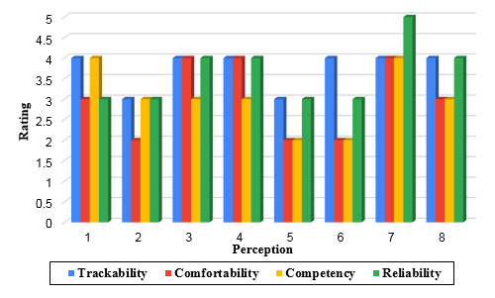
Result Analysis
Objectives
Otcome
Results & Discussion
Perception (RQ1)
Participants viewed Nao's touch-based health monitoring favorably, with a scope for enhancing comfort and confidence levels further.
Fig. 7 : Perception of touch rated against tractability, comfortability, competency, and reliability

Slide 25
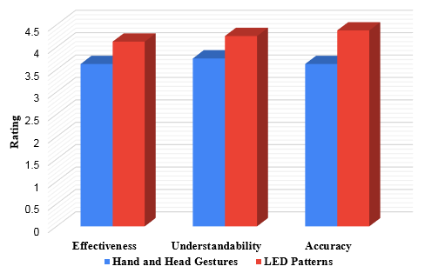
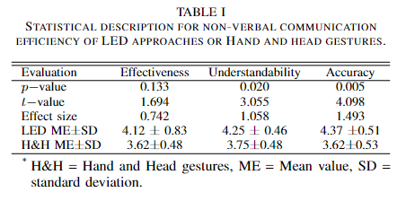
Result Analysis
Objectives
Otcome
Results & Discussion
Efficiency of Nonverbal Communication (RQ2)
LED patterns are perceived as better than hand and head gestures in terms of understandability and accuracy
Fig. 8: Non-verbal communication efficiency (either LED or hand gesture approaches) rated against effectiveness, understandability and accuracy.

Slide 26
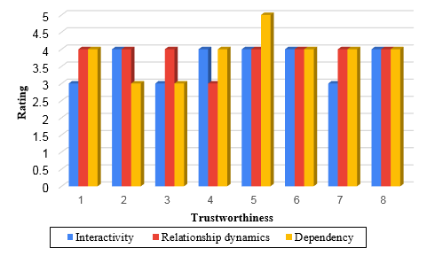
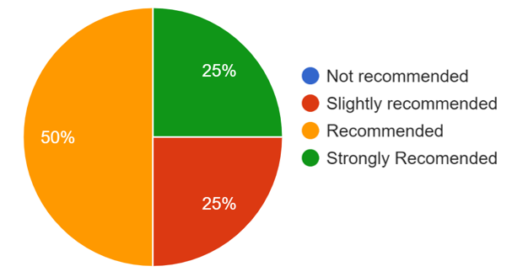
Result Analysis
Objectives
Otcome
Results & Discussion
Trustworthiness (RQ3)
Participants recommended Nao rather than human caregiver.
Fig. 9: Trustworthiness rated against interactivity, relationship dynamics, and ndependency
Fig. 8: Percentage of Trust Level

Slide 27
Discussion
Objectives
Otcome
Results & Discussion
Nao's touch-based health monitoring: Easy to understand, moderately comfortable, competent, and reliable.
LED patterns vs. gestures: LED patterns favored for understandability and accuracy.
Trust dynamics: Longer interactions correlated with increased trust, emphasizing importance of engagement.

Slide 28
Conclusion
Objectives
Otcome
Conclusion & Limitations
Our findings suggest that Nao's touch-based health monitoring was well-received by participants, with positive ratings
We can conclude Nao can be used as an caregiver for monitoring the health condition of Elderly people
Limitation & Future Works
Sample size in this study is very small. In future studies, efforts should be made to expand participant recruitment
Moreover, conducting the study without ethical approval raises ethical concerns regarding participant consent and data privacy.
We have designed in Webots simulation, however, real scenarios could be more complex.

Slide 29
References
N. Nachiappan, S. Ward, N. Chockalingam, and R. Chambers, “Can simple household assistive products enhance the self-care of health and well-being?” Journal of Integrated Care, vol. 31, no. 2, pp. 132–145, 2023.
A. Robaczewski, J. Bouchard, K. Bouchard, and S. Gaboury, “Socially assistive robots: The specific case of the nao,” International Journal of Social Robotics, vol. 13, pp. 795–831, 2021.
A. Bonarini, “Communication in human-robot interaction,” Current Robotics Reports, vol. 1, no. 4, pp. 279–285, 2020.
S. Saunderson and G. Nejat, “How robots influence humans: A survey of nonverbal communication in social human–robot interaction,” International Journal of Social Robotics, vol. 11, no. 4, pp. 575–608, 2019.
K. Dautenhahn, “Socially intelligent robots: dimensions of human–robot interaction,” Philosophical transactions of the royal society B: Biological sciences, vol. 362, no. 1480, pp. 679–704, 2007.
D. O. Johnson, R. H. Cuijpers, K. Pollmann, and A. A. van de Ven, “Exploring the entertainment value of playing games with a humanoid robot,” International Journal of Social Robotics, vol. 8, pp. 247–269,2016.
N. Akalin, A. Kiselev, A. Kristoffersson, and A. Loutfi, “An evaluation tool of the effect of robots in eldercare on the sense of safety and security,” in Social Robotics: 9th International Conference, ICSR 2017,
Tsukuba, Japan, November 22-24, 2017, Proceedings 9. Springer, 2017, pp. 628–637.

Slide 30

Any Questions?

